Slide 1
Creating a weights file to blur values, given a shapefile with varying numbers of p-regions

Slide 2
Methods
Example input shapefiles of regions:
'inputs/shapefiles/US_COUNTY_2022/US_COUNTY_2022.shp’
'inputs/shapefiles/US_PCA/US_PCA.shp’
Method:
Uses the distance from each centroid to each census boundary and a simple exponential decay of weights as distance from centroid to census boundary increases
- In supplementary slides:
Additional (unused) “Adjusted weights” method: same decay method, but added a weight to the regions inside the census division. Correspondingly adjusted other weights for each respective p-region.
See ‘Supplement_other_method_weighting.xlsx’ for more details

Slide 3
Testing different decay lengths using the ‘unadjusted’ weights method (we decided on the 150 km decay length)

Slide 4
County-level resolution input shapefile

Slide 5
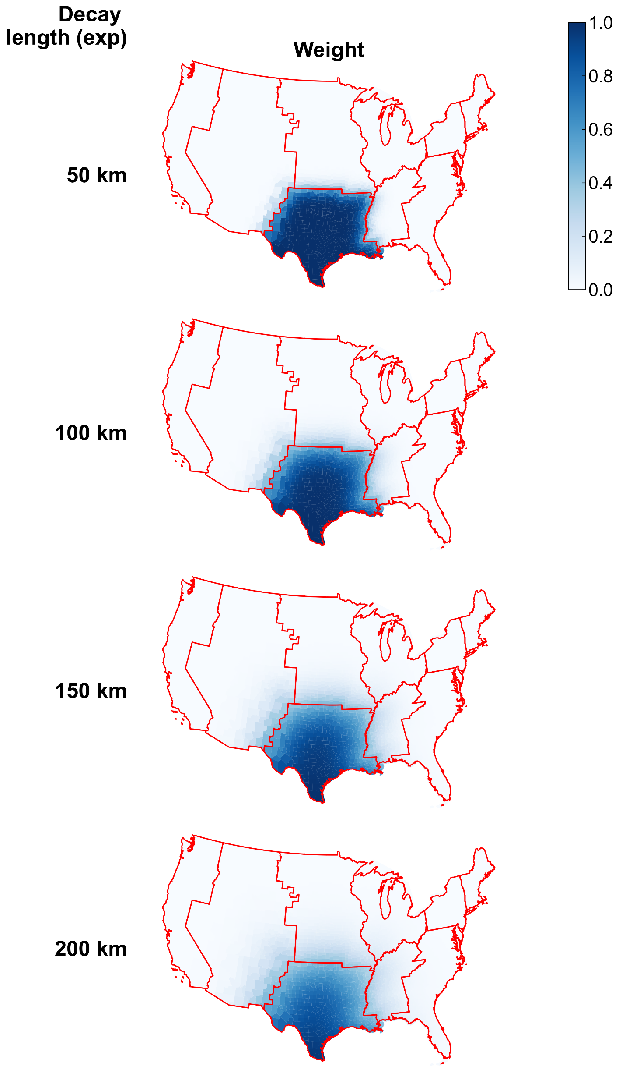
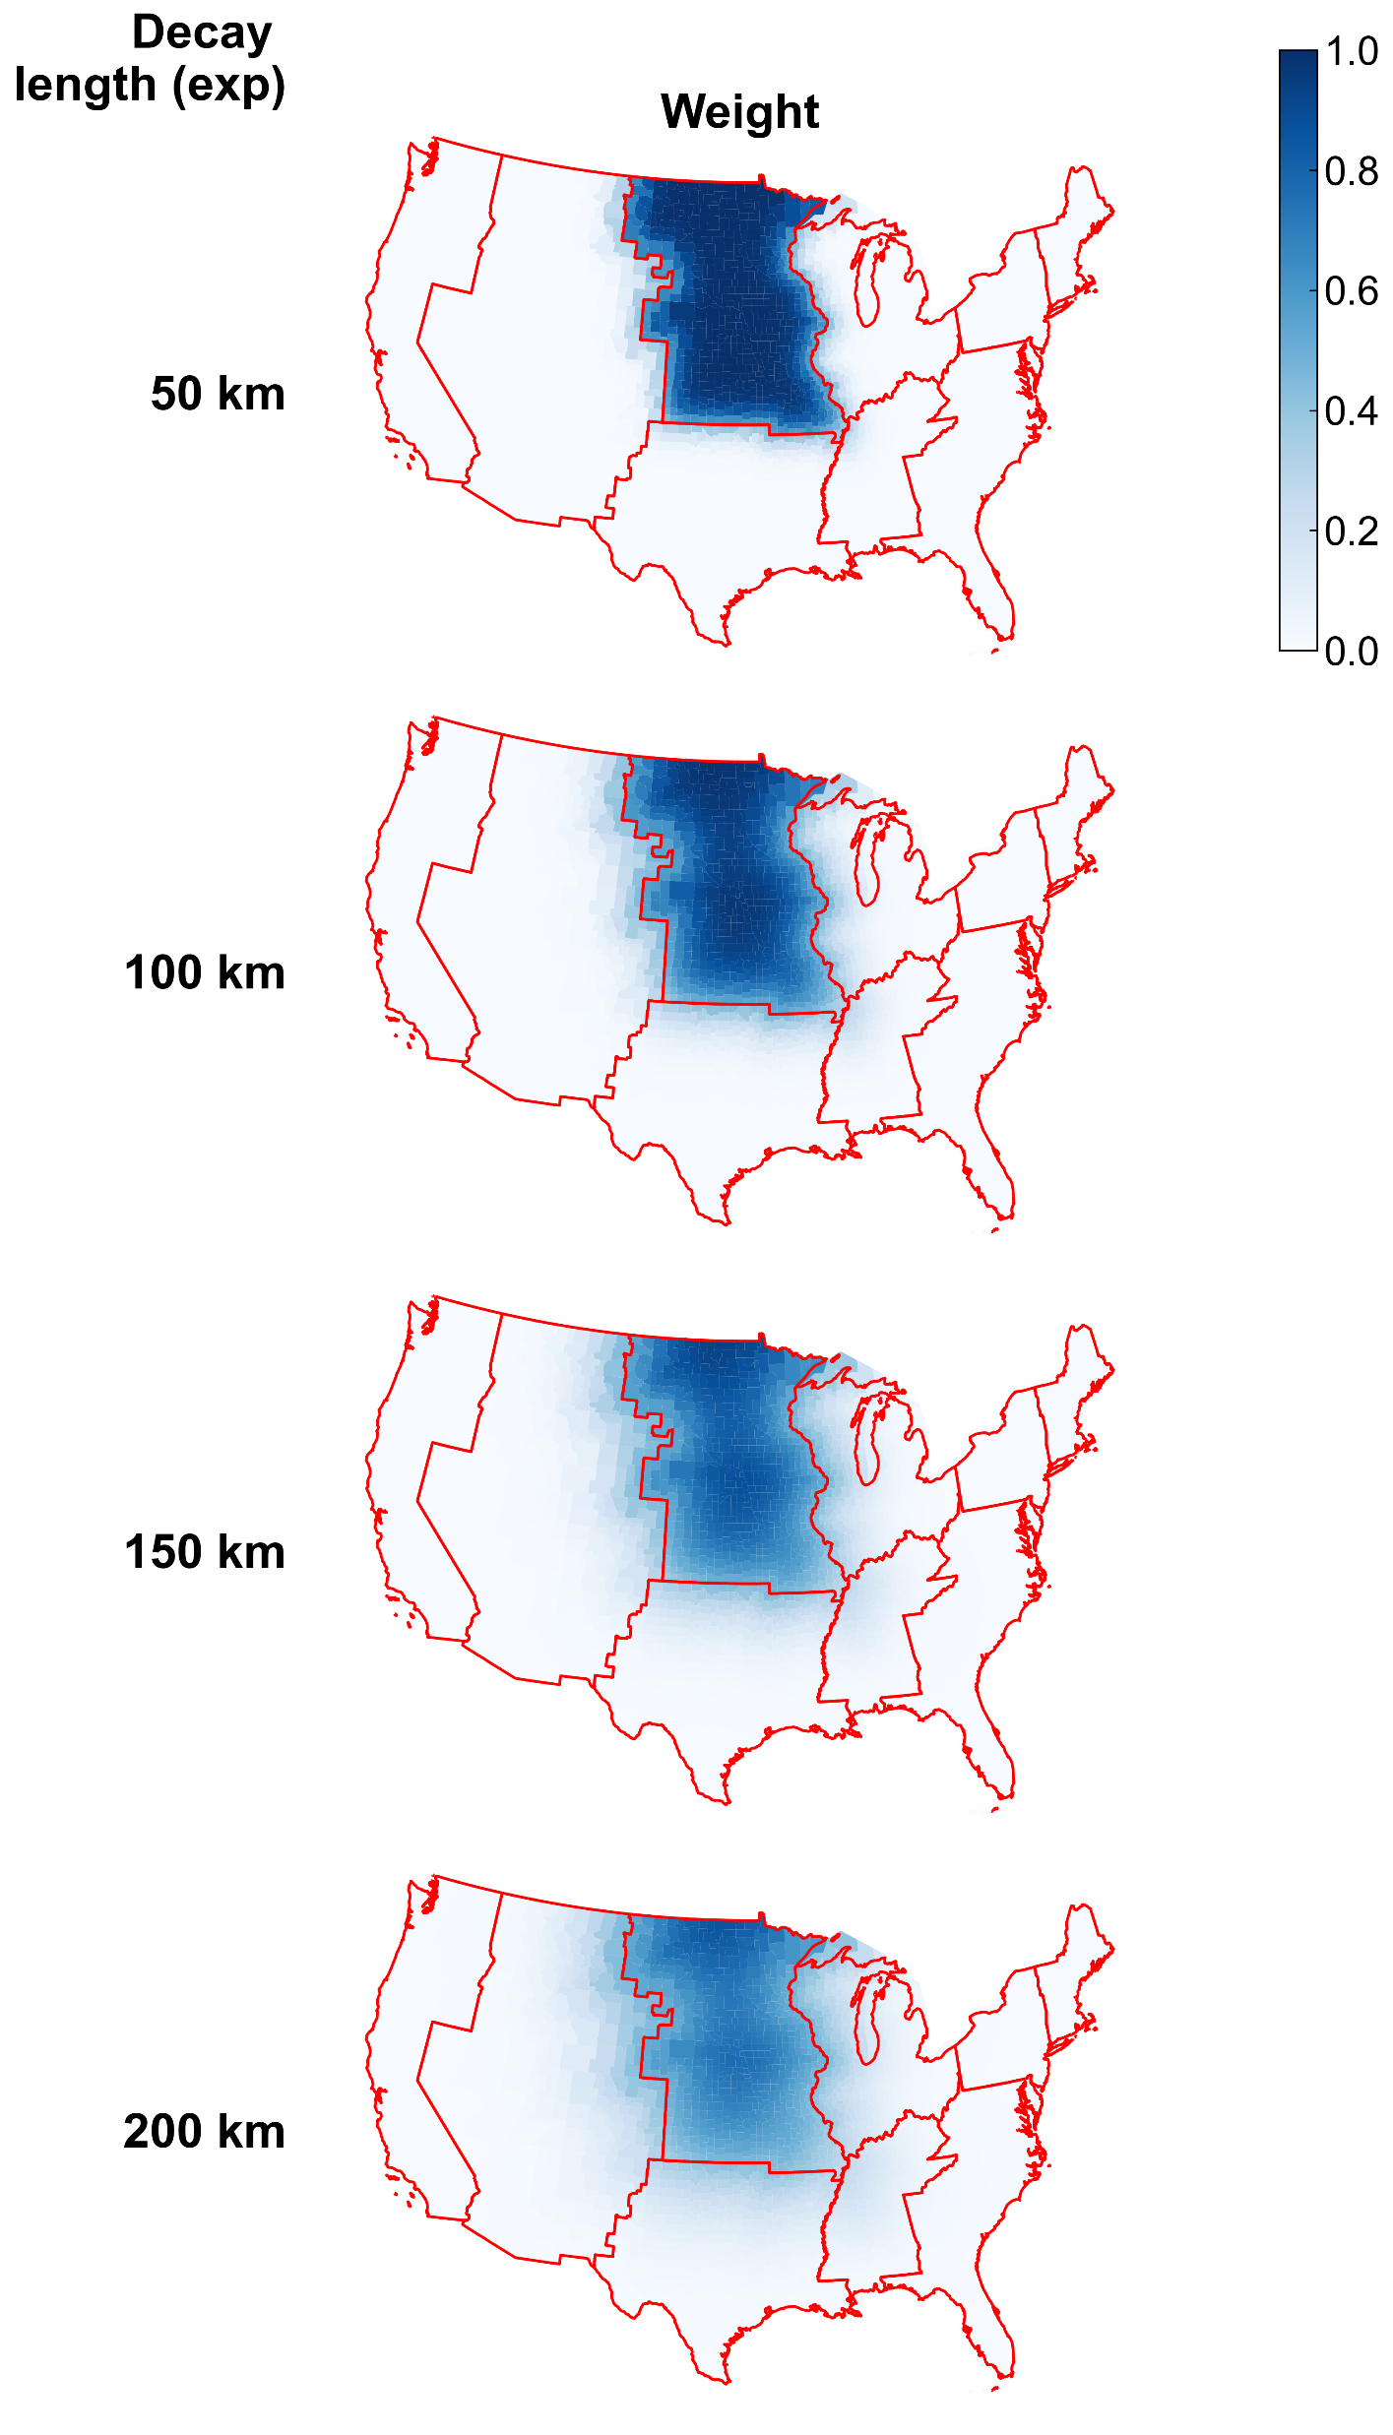
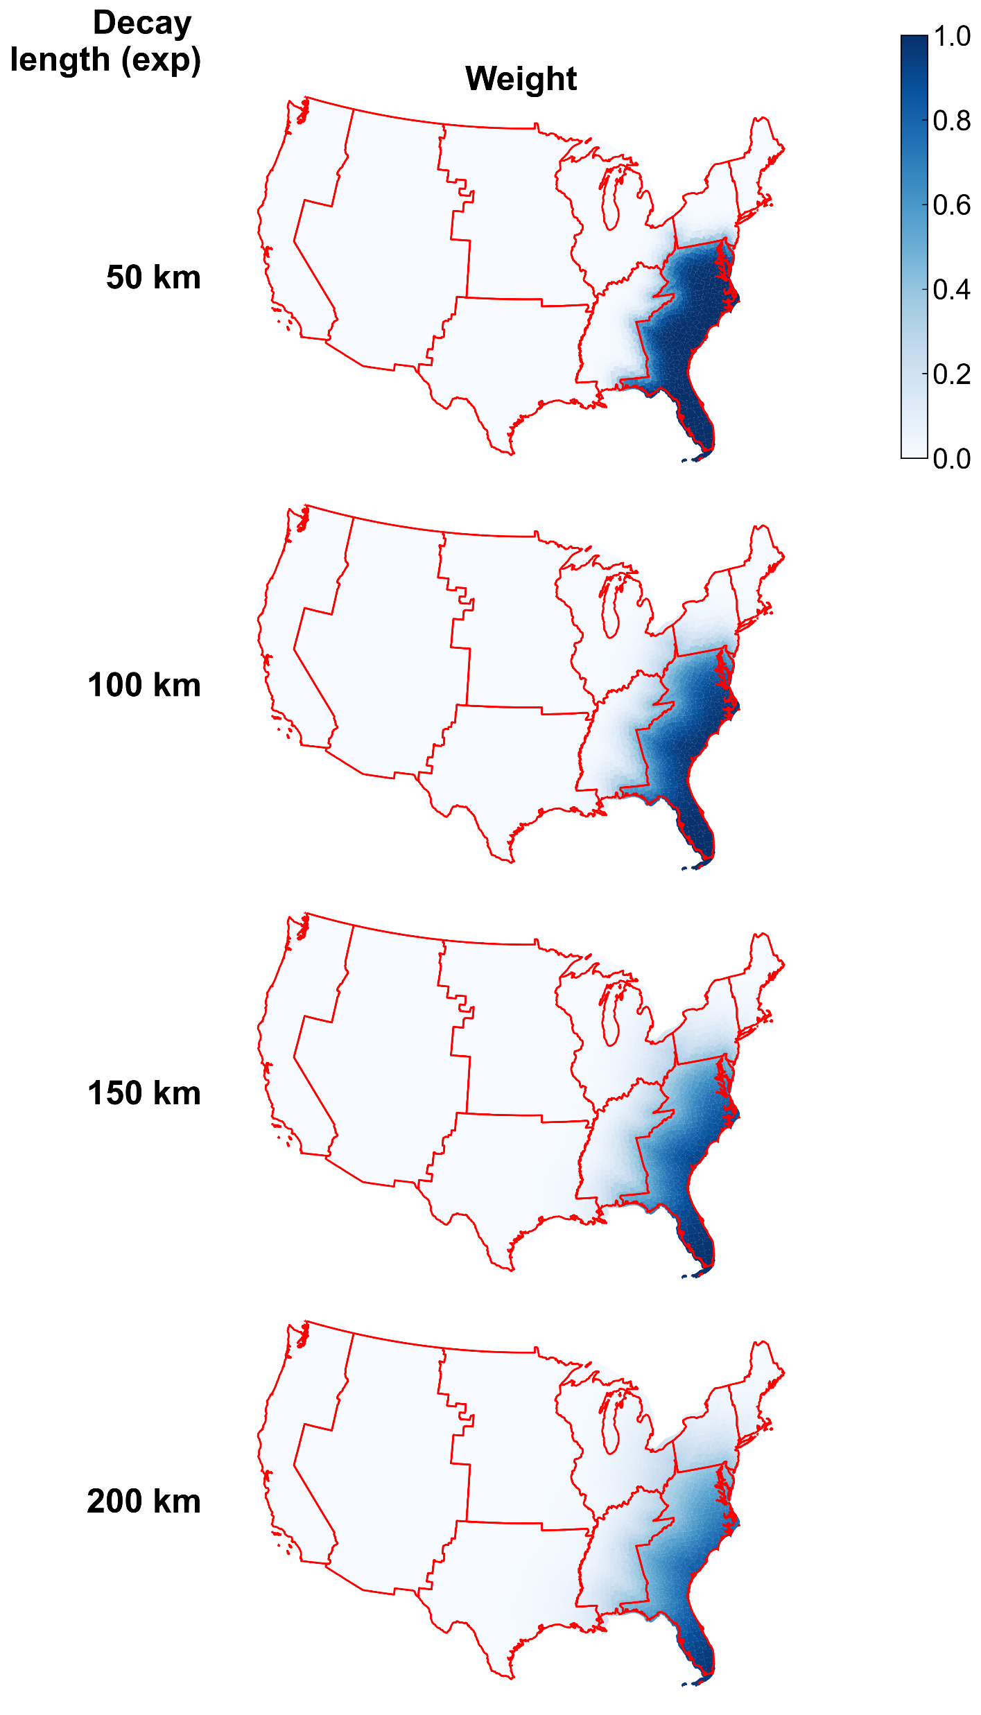

Slide 6
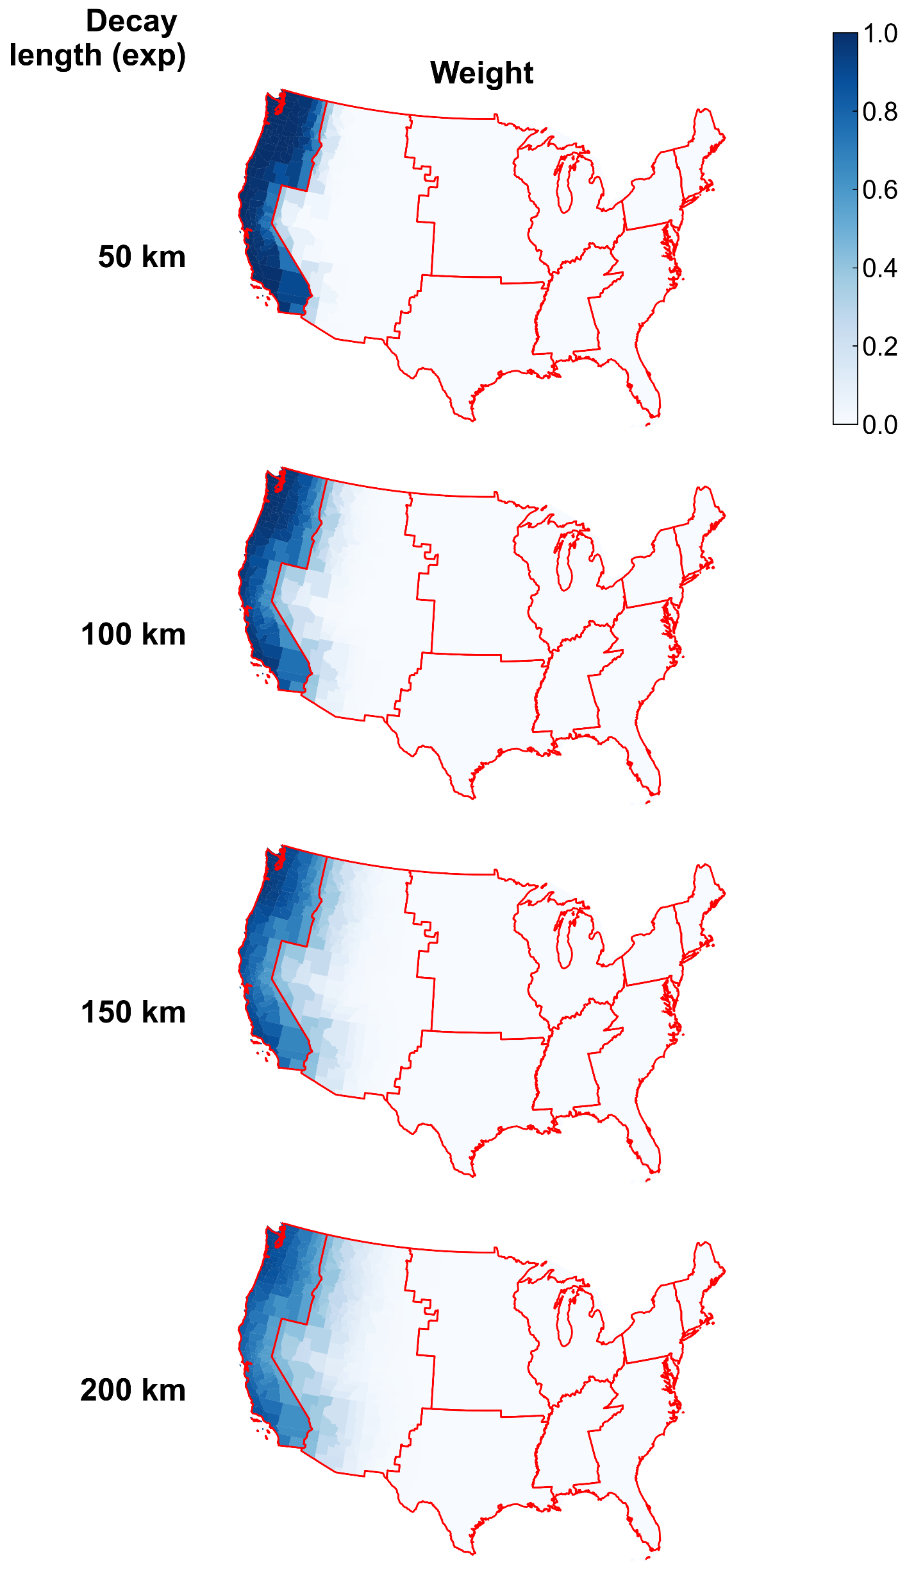
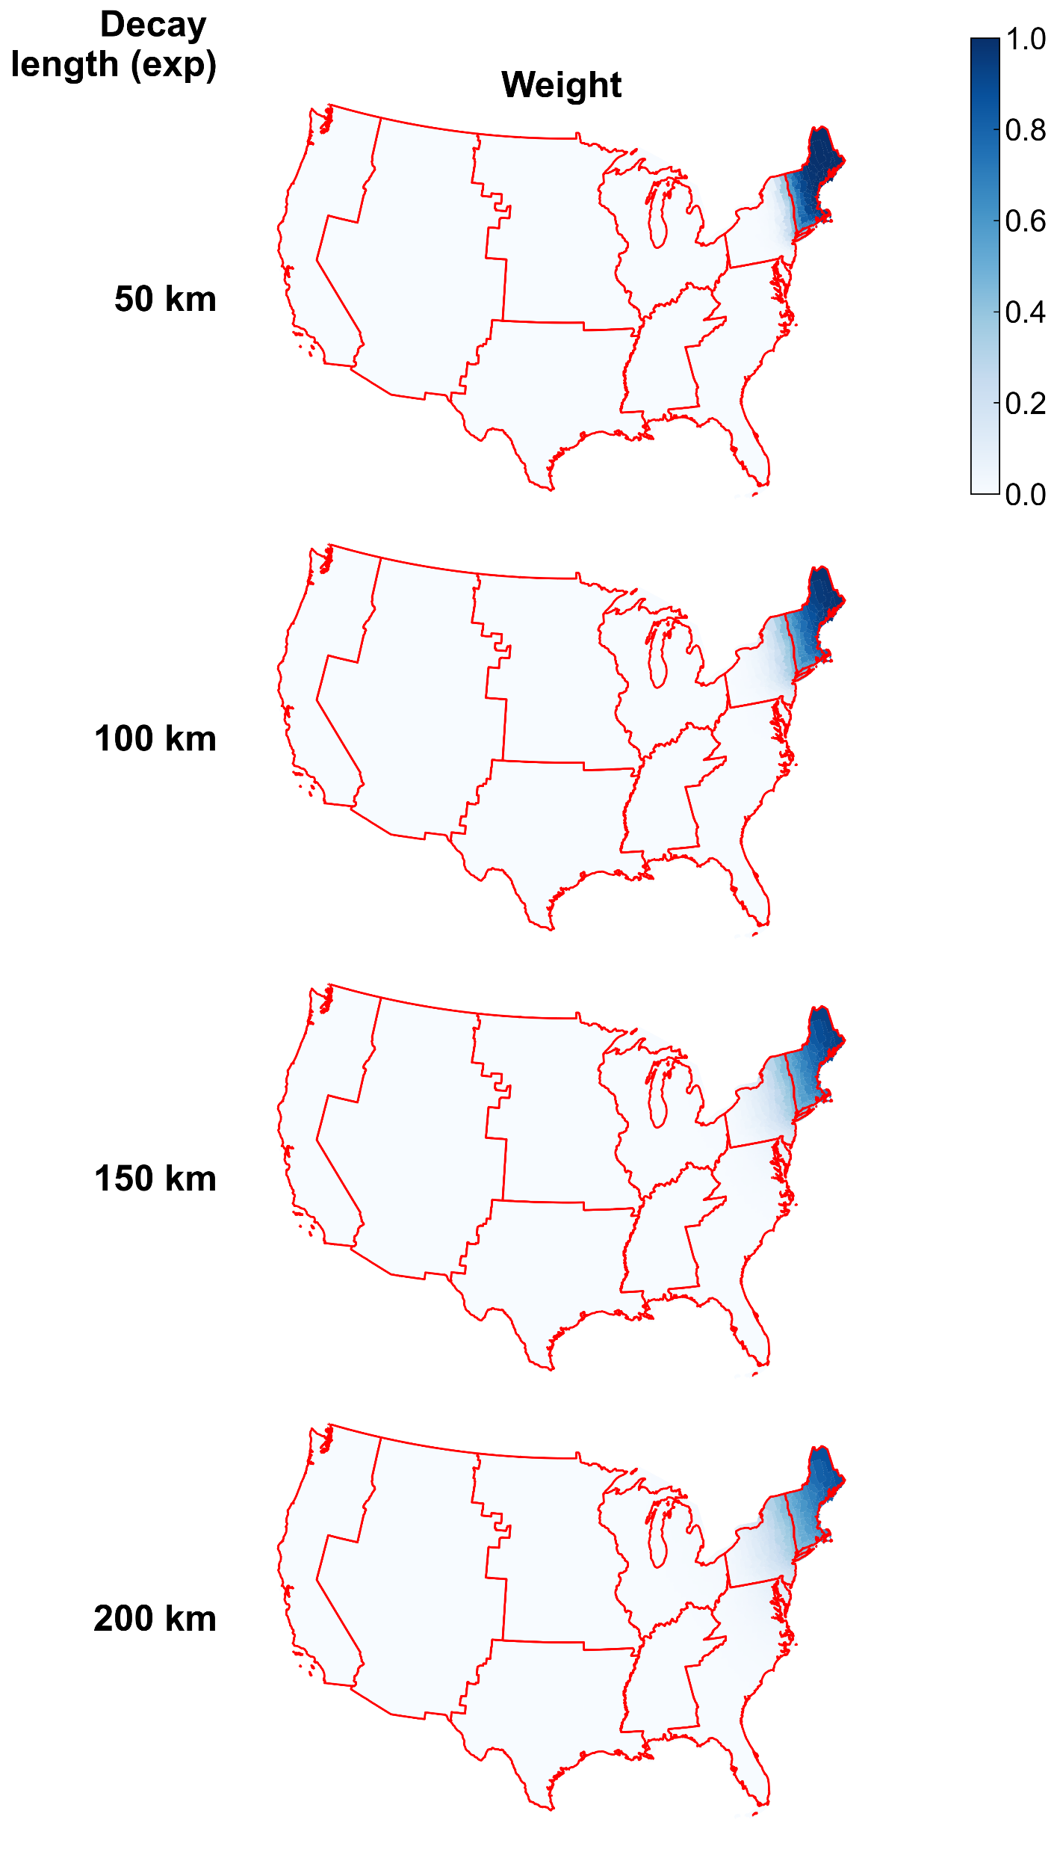
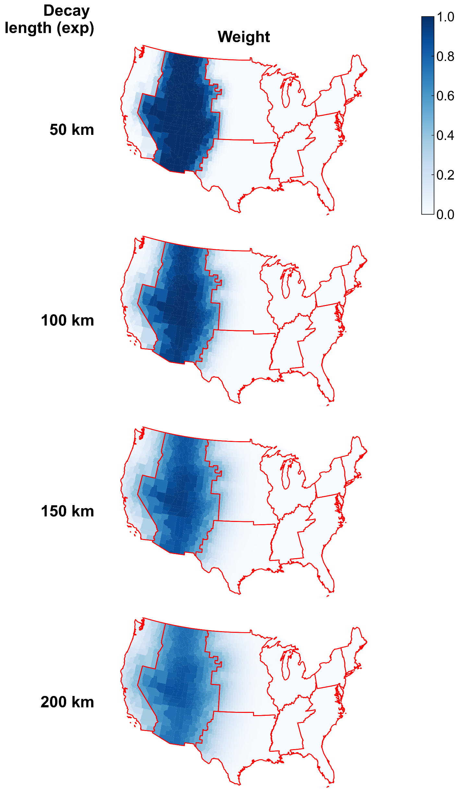

Slide 7
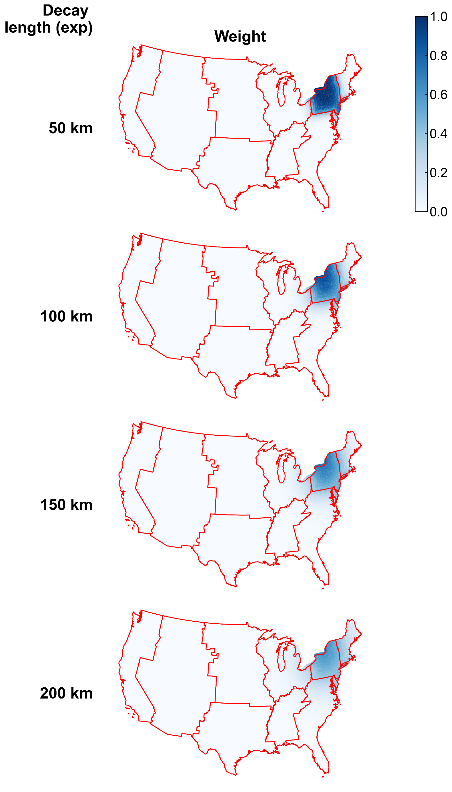
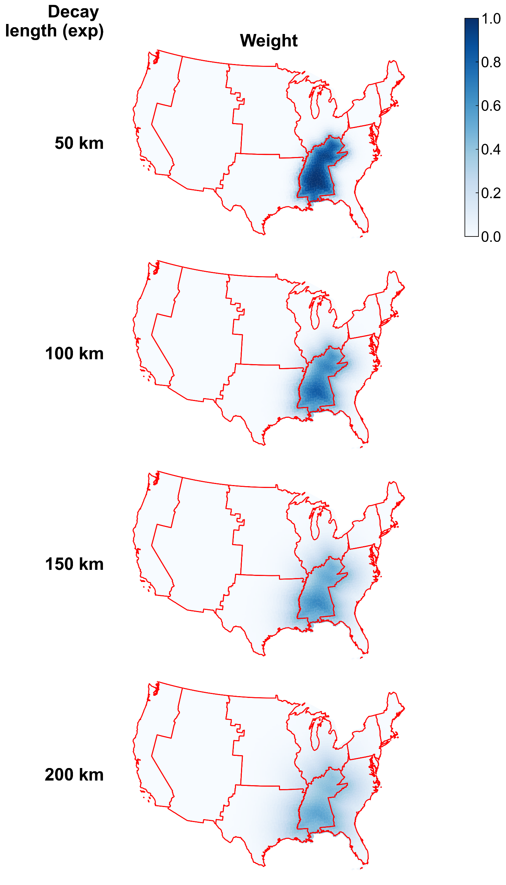
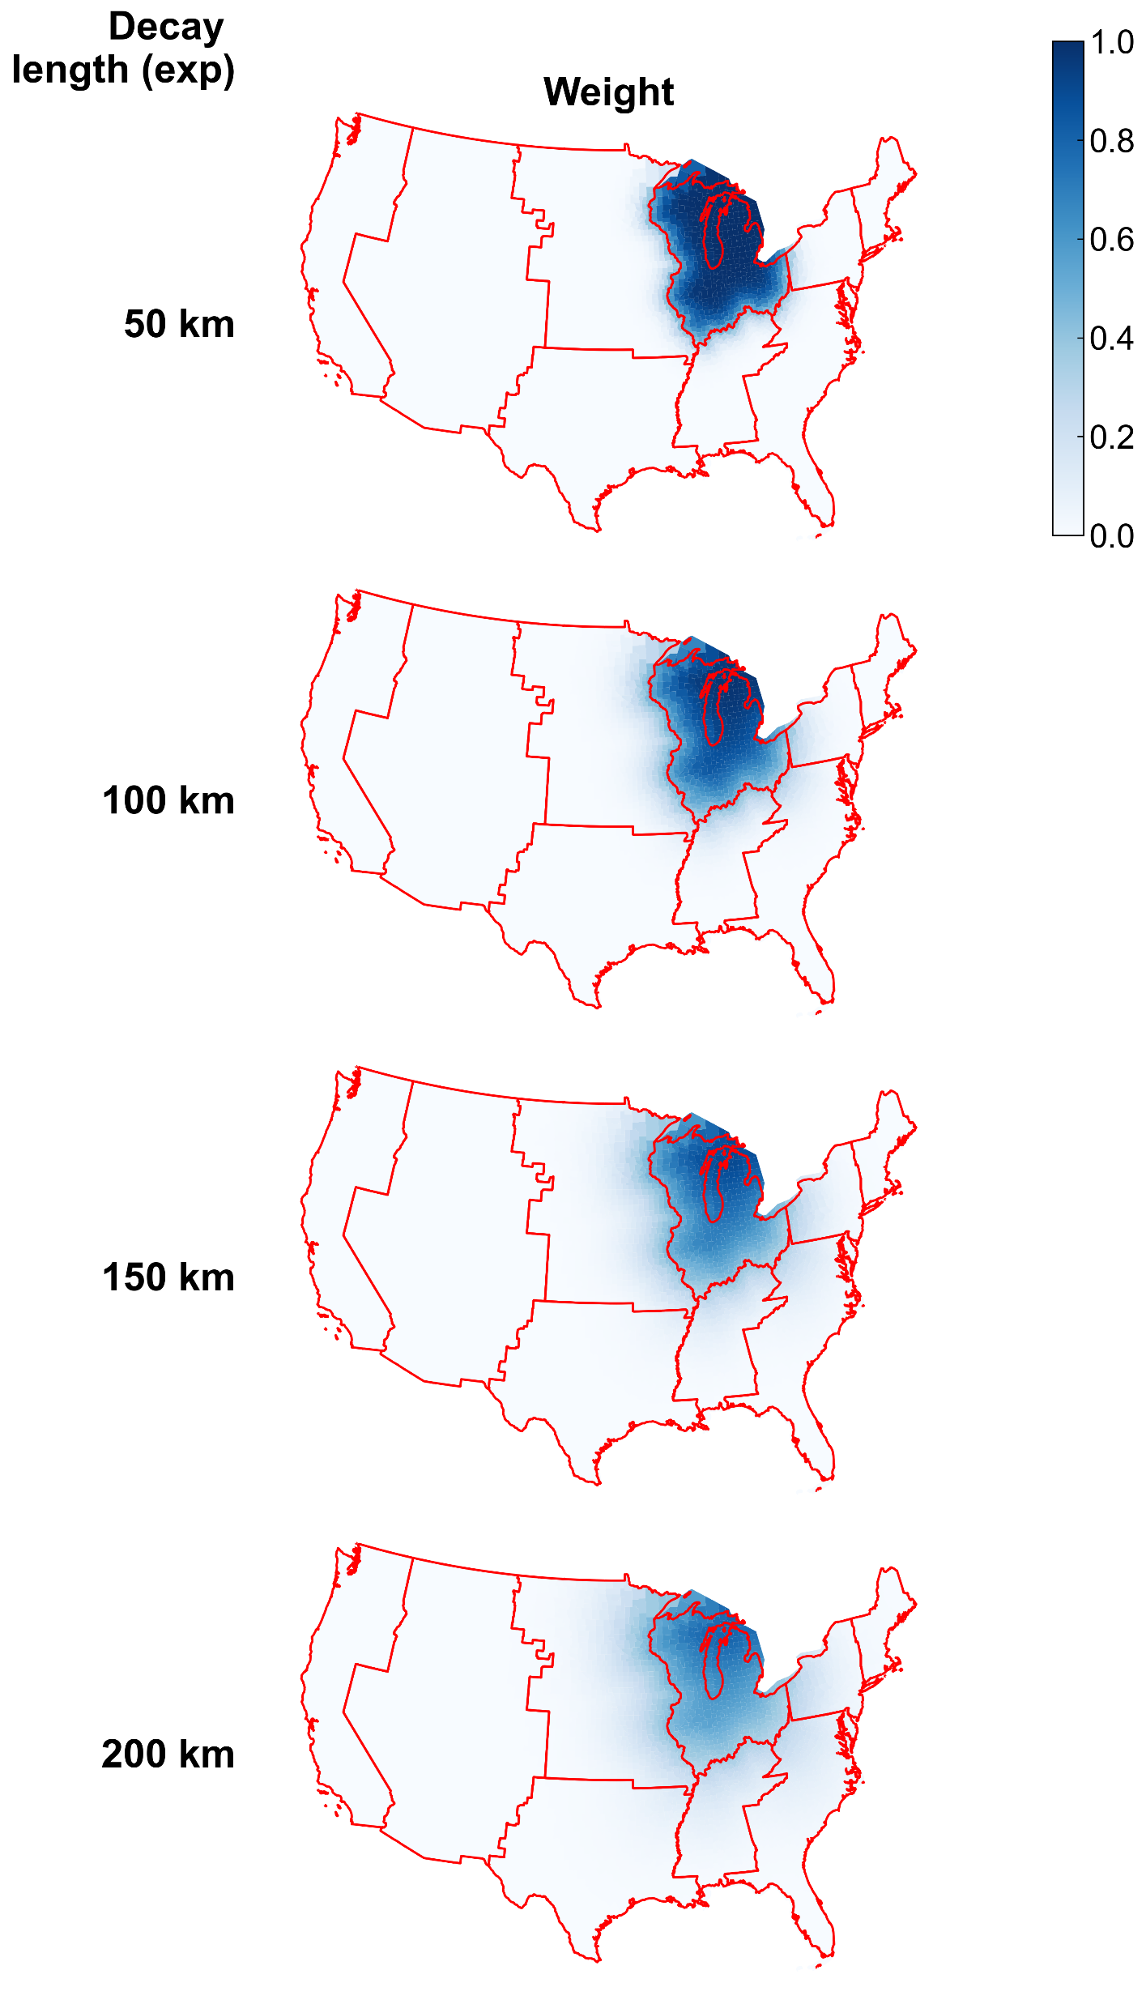

Slide 8
Coarser resolution (p-region level) as input shapefile

Slide 9
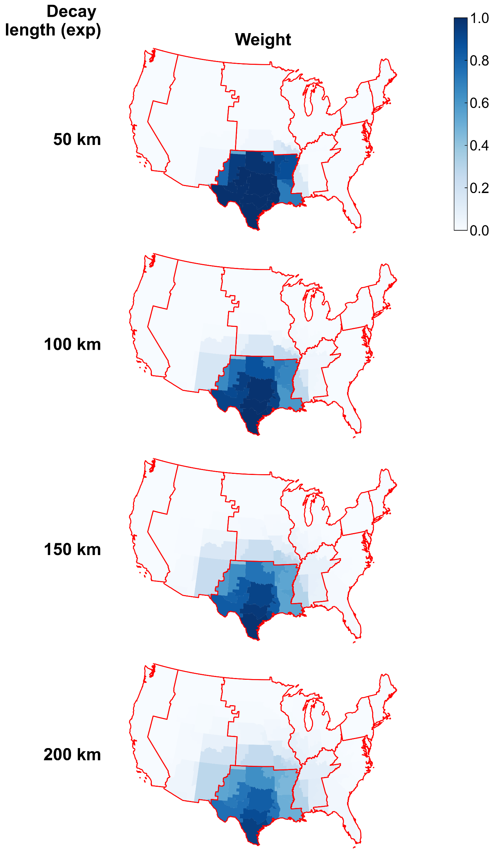
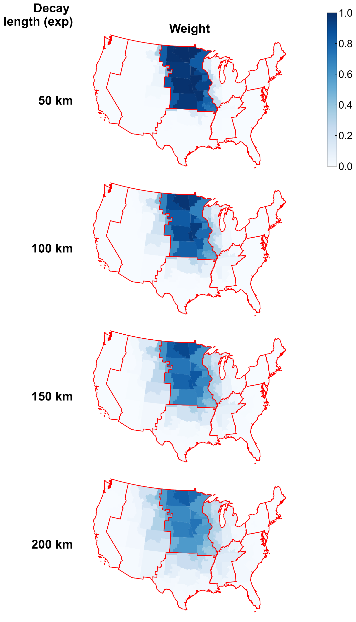
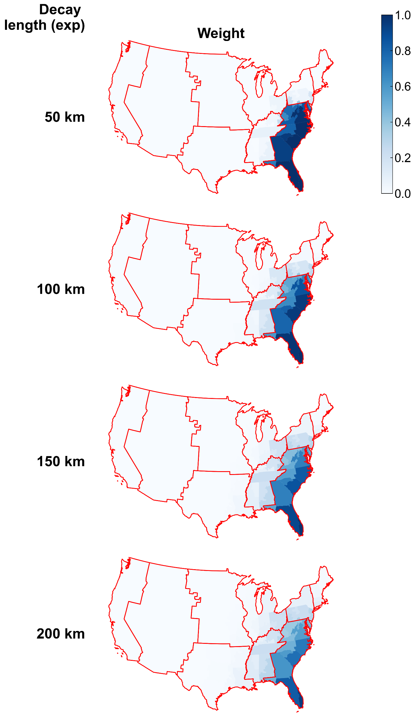

Slide 10

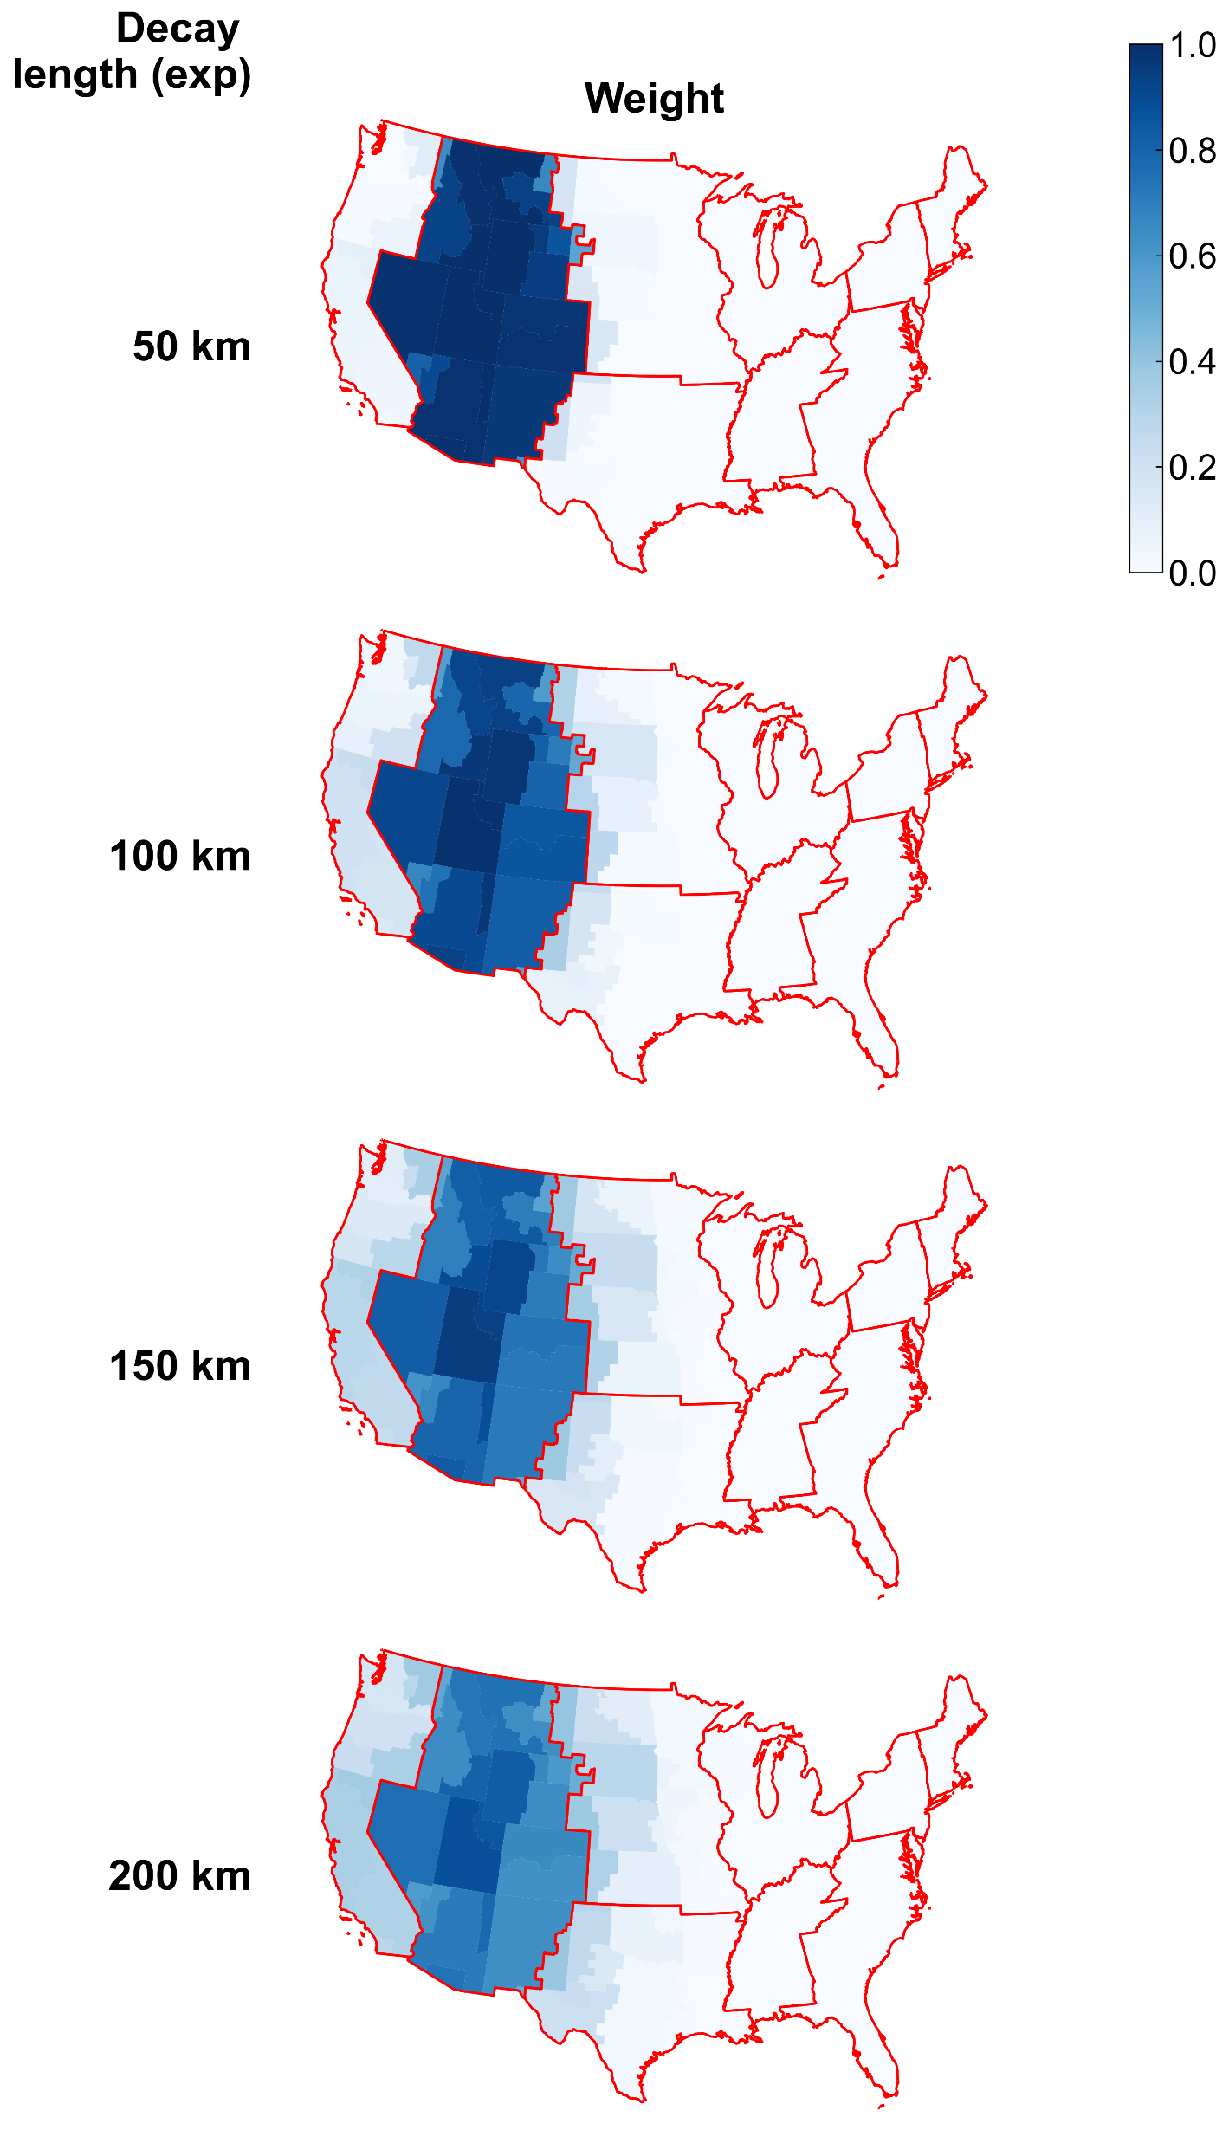
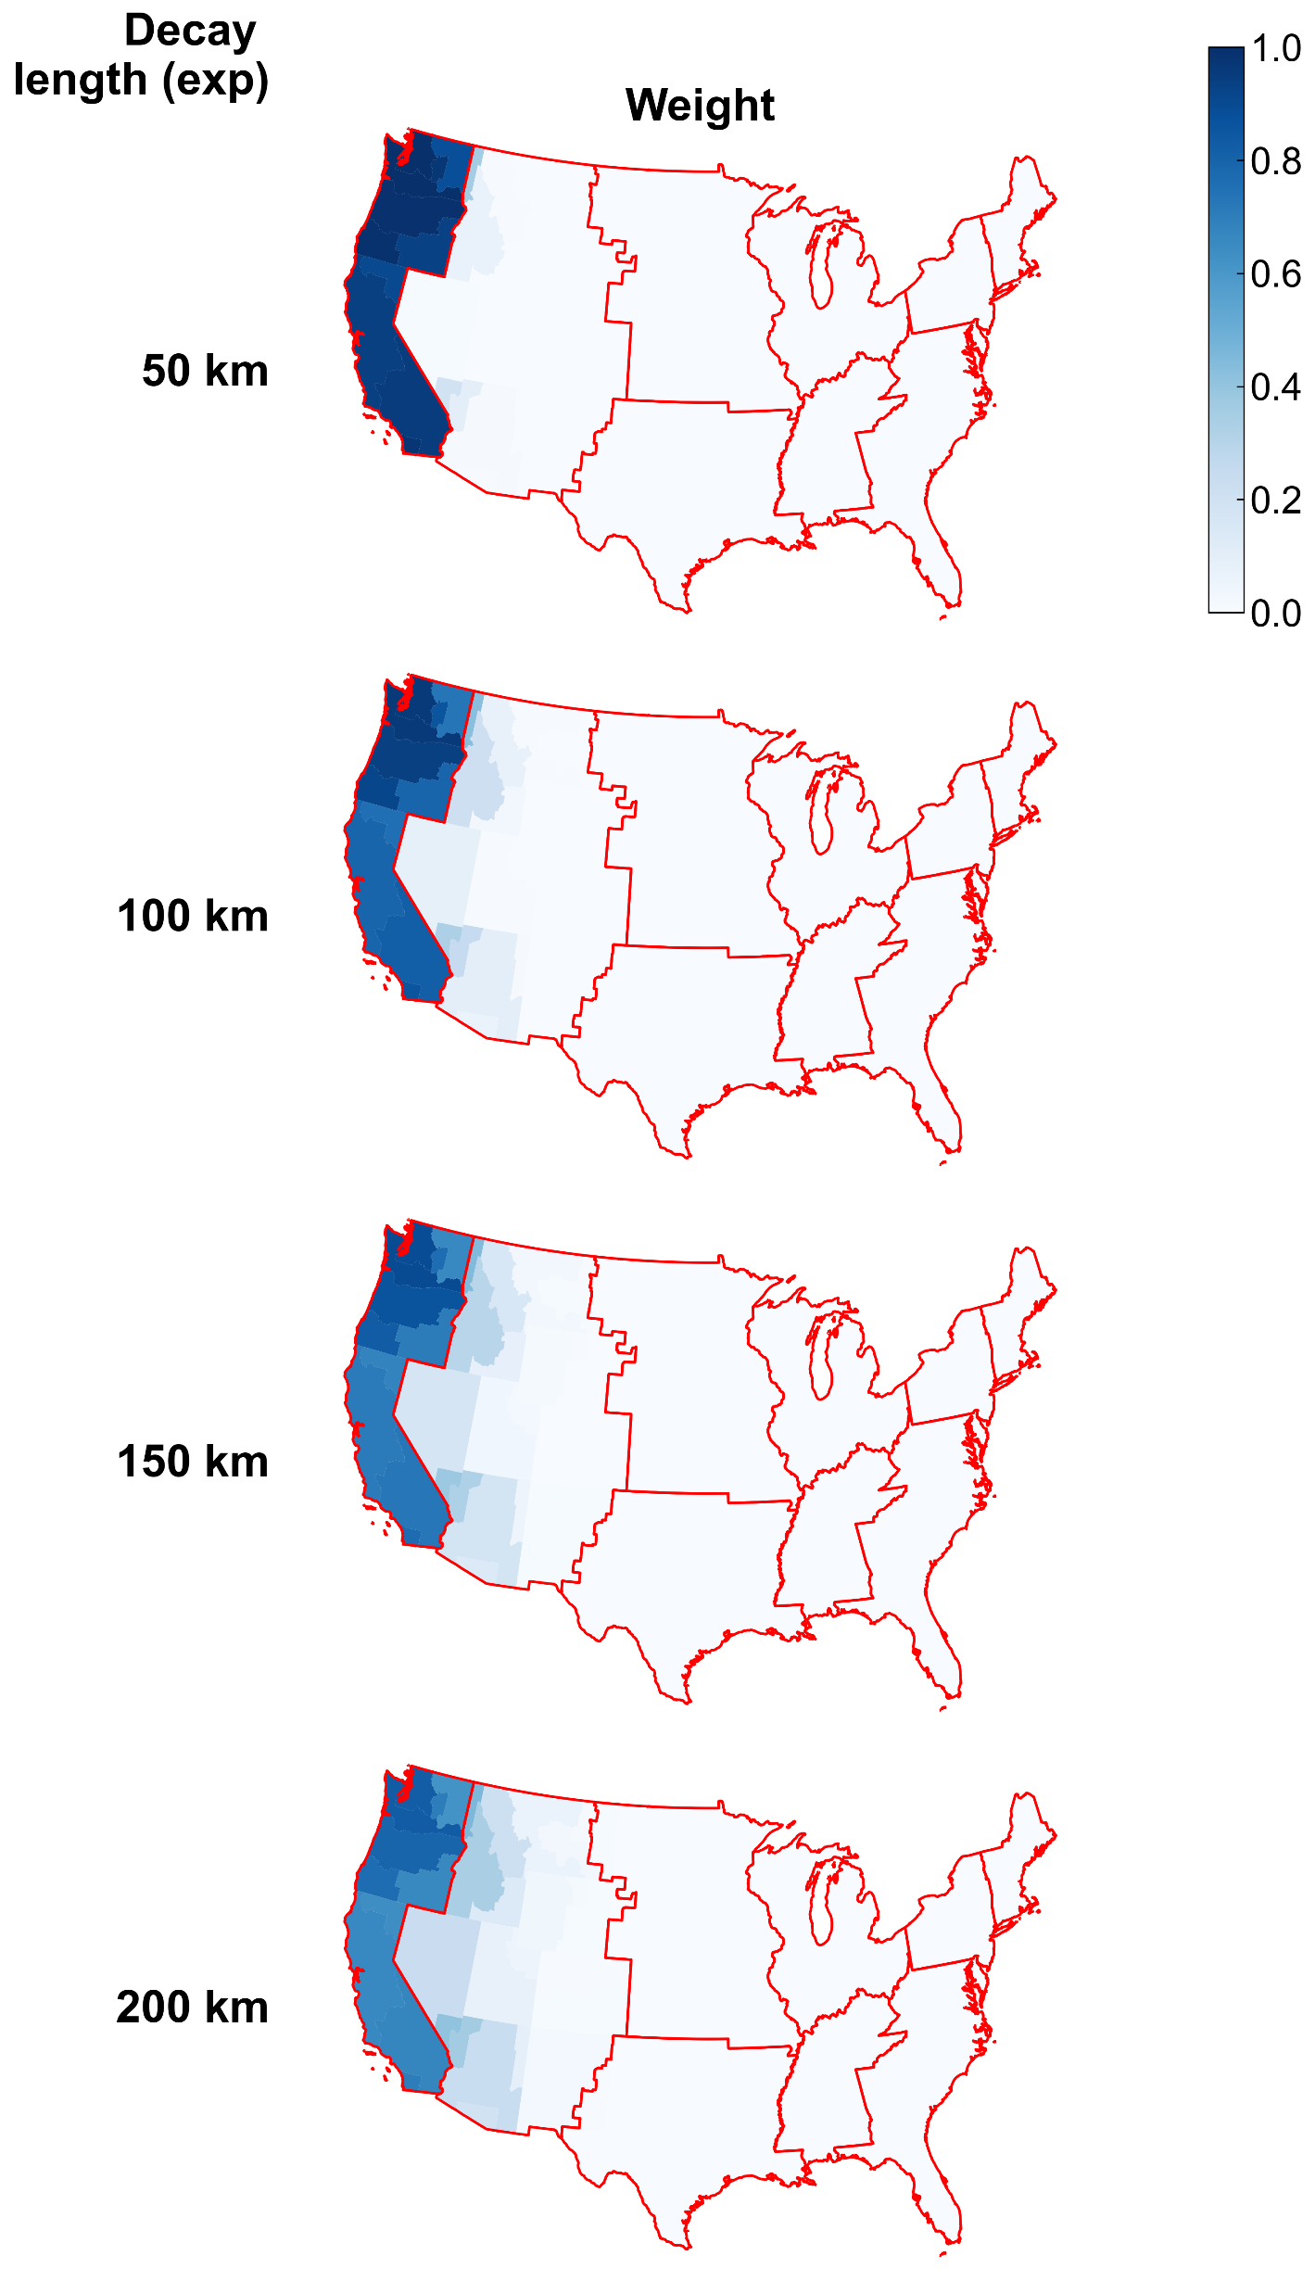

Slide 11
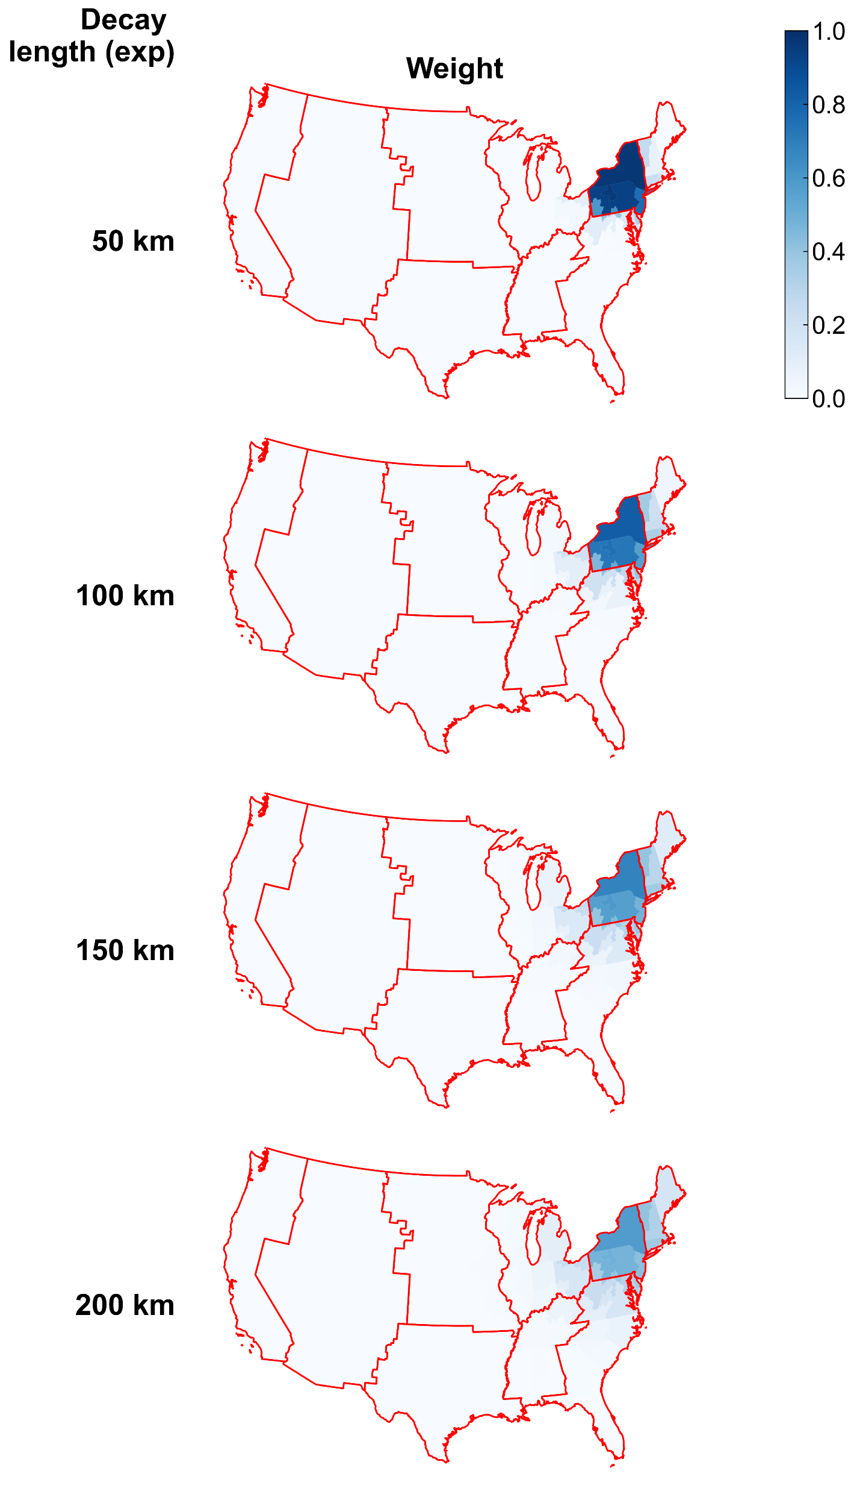

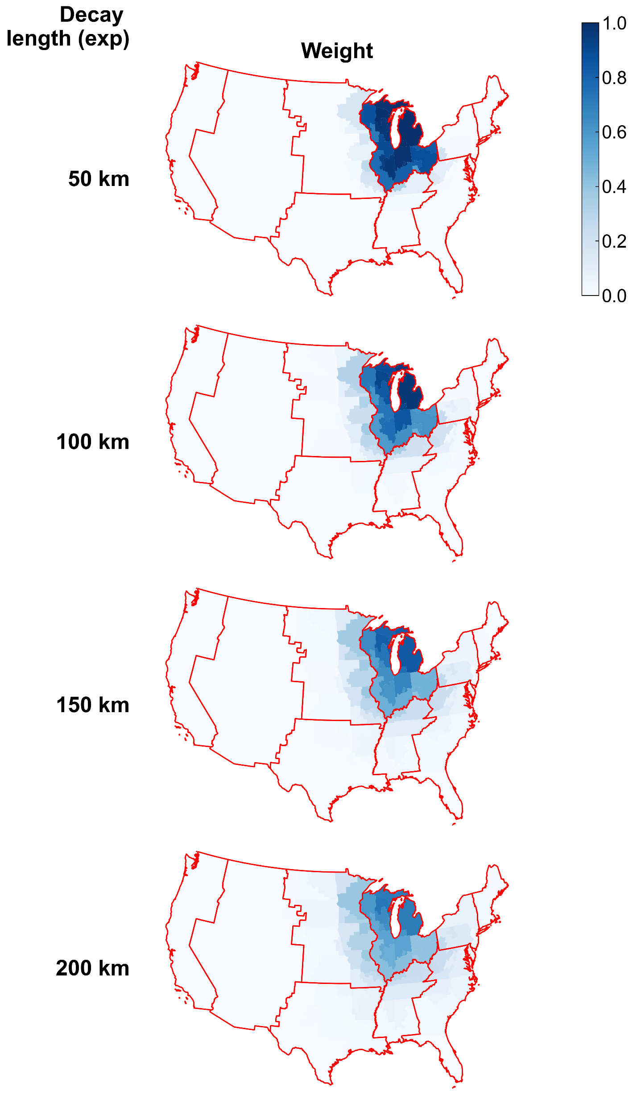

Slide 12
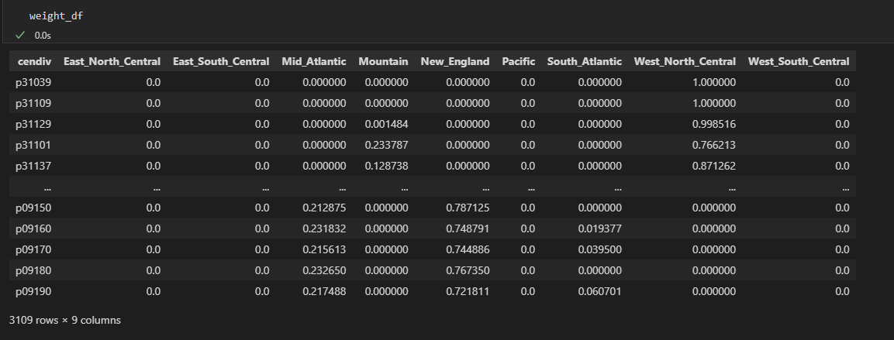
Example output of weights

Slide 13
Supplementary slides: A second methodology that didn’t look as good but placed here for reference

Slide 14
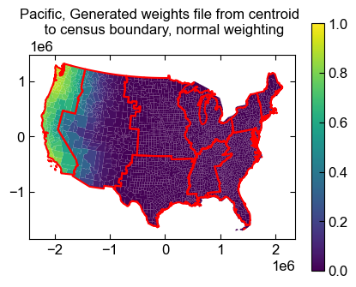
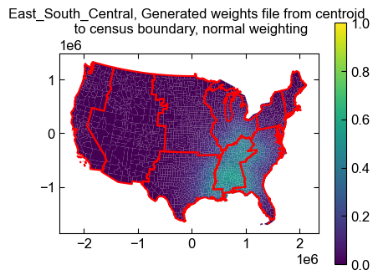
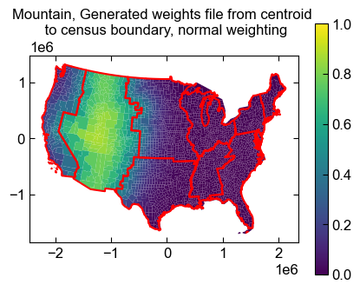
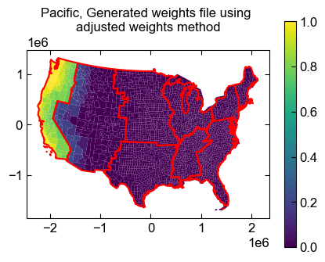
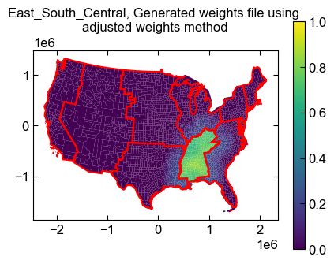
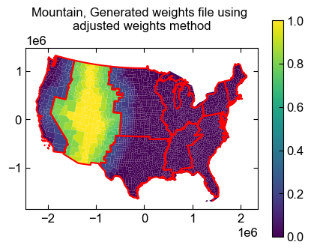
Top row: “Unadjusted weights (exp decay)” method (the chosen method used in the previous slides).
Bottom row: “Adjusted weights” method with more weight put in the regions inside each cendiv

Slide 15
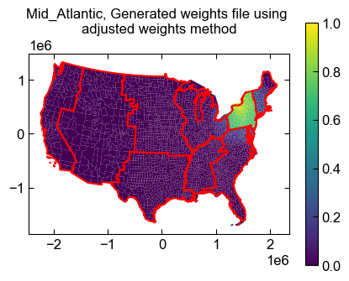
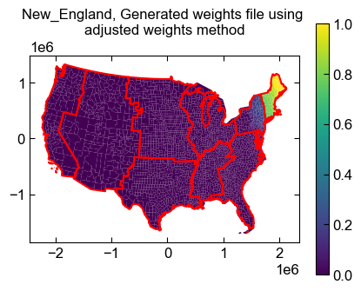
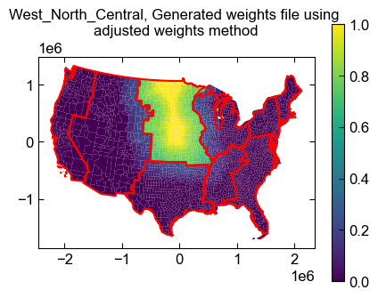
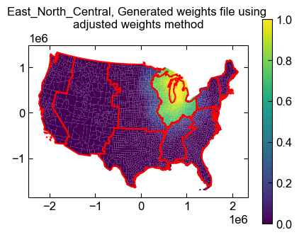
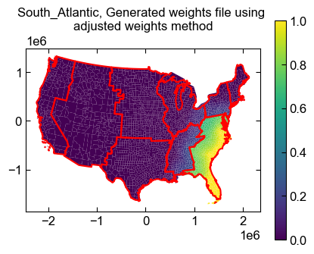
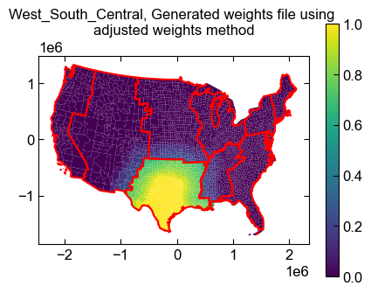
Rest of census divisions using “Adjusted weights” method

Slide 16
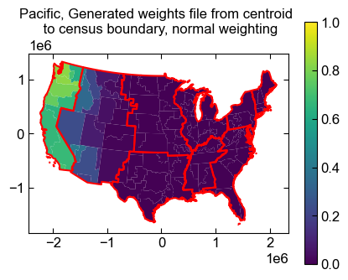
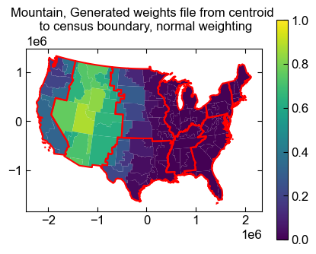
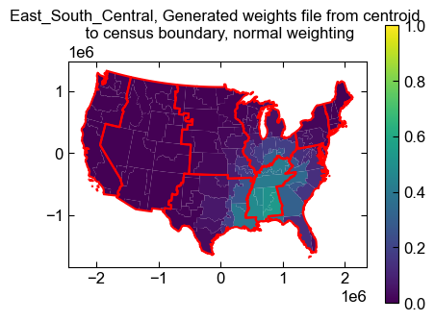
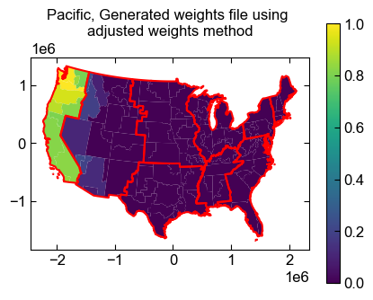
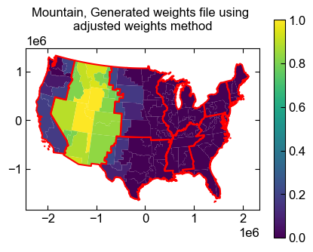
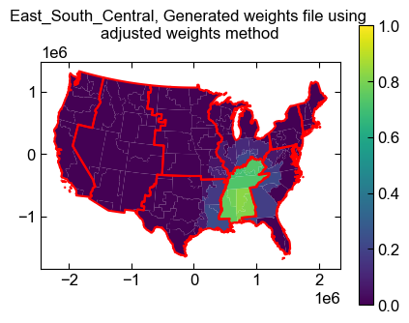
Coarser input file: Top row: “Unadjusted weights” method. Bottom row: “Adjusted weights” method

